Slide 1

Modeling the variability of the obstruent lenition in Seoul Korean: Prosody, Phonological context and Predictability
Apr 27 2024
PhPhone at UMass Amherst
Seung Suk Lee

Slide 2

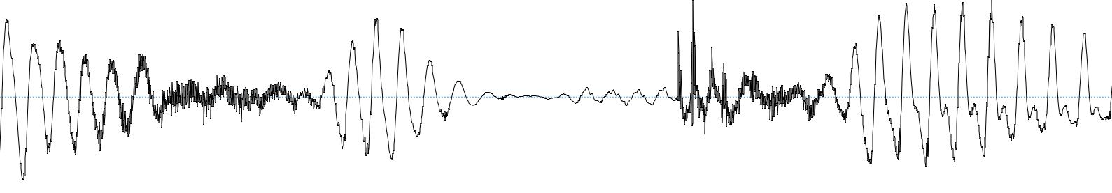
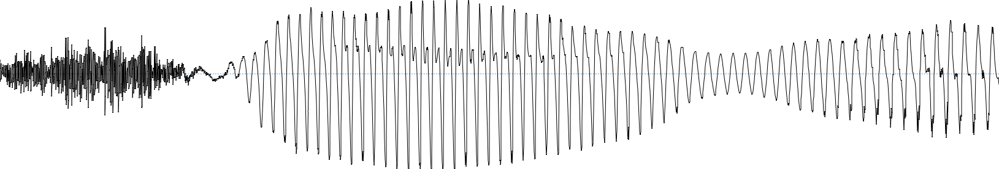
Phonetic realization of lenis obstruents in Seoul Korean
/hak’joesƆkikwane/ ‘The school-LOC the institution-DAT’
… | s | Ɔ | k | i | …
/tʃʰusƆkiɾaŋ/ ‘Chuseok (Korean Thanksgiving) and…’
Voiced,
AND
Reduced
Shortened
… | s | Ɔ | k | i | …

Slide 3
/k/ in word-initial position (& phrase-initial)
/ha.k’jo.e.sƆ # ki.kwa.ne/ ‘The school-LOC the institution-DAT’
… | s | Ɔ | k | i | …
The phonetic realization of lenis obstruents is conditioned by the prosodic position.
But is there anything else?
/k/ in word-medial position (& phrase-medial)
/tʃʰu.sƆ.ki.ɾaŋ/ ‘Chuseok (Korean Thanksgiving) and…’
… | s | Ɔ | k | i | …

Slide 4
Research questions:
What factors cause obstruents to lenite?
Prosodic position
Predictability
Phonological context (neighboring vowel height)
How do these factors interact with each other?
Test case: Variable realization of the lenis obstruents in a Seoul Korean spontaneous speech corpus

Slide 5
Previous work on the lenis obstruents
Lenis obstruents are voiced in the Accentual Phrase (AP) medial position
They are voiceless in the Accentual Phrase (AP) initial position
Optional and gradient
AP medial voiceless tokens, AP initial voiced tokens both found
Degree of voicing varies (fully voiced – fully voiceless)
Speech rate
Faster speech → more likely to be fully voiced
Individual variation
Jun 1994, Jun 1998, Han 2000, Yoo 2020

Slide 6
Lenis obstruent voicing lenition
Lenis obstruents are
approximantized/fricativized in the AP-medial position
shortened in the AP-medial position
deleted in the AP-medial position
These realizations suggest that we should investigate the realization of lenis obstruents as a lenition phenomenon
Very little work on the variable realization of the lenis obstruent,
other than voicing,
and other than the effect of prosodic position/speech rate
Silva 1992, SH Lee 1995, Yoo 2020, JS Kim et al 2016 Choi et al 2006

Slide 7
Obstruent lenition
In many languages, obstruents are often lenited in connected speech
Synchronic variable process where a segment is realized as “weak”
Voicing
Fricativization
Approximantization
… others like tapping, debuccalization (/f/→/h/) etc.
Deletion: As it keeps getting weak, it could eventually become inaudible
Acoustically similar: Voiced/Fricativized/Approximantized/(deleted) segments are _____ compared to their counterparts
Shorter
More vowel-like
More sonorous

Slide 8
Why do speakers lenite obstruents?
NoBoundary (#acoustic, #perceptual, #prosodic)
e.g., Kingston 2008; Ennever et al 2017 ;Katz and Pitzanti 2019
LowInfo (#functional, #exemplar-theoretic)
e.g., Cohen Priva 2017, DiCanio et al 2022, Kilbourn-Ceron et al 2020
MinEffort (#articulatory)
e.g., Kirchner 1998

Slide 9
NoBoundary #acoustic, #perceptual, #prosodic
Obstruents tend to be lenited in the medial position of a prosodic constituent (word/phrase) as opposed to the initial position
Intervocalic
Word-medial (vs. Initial)
Phrase-medial (vs. Initial)
Unstressed syllable (vs. Stressed)
These are also called: “prosodically weak positions”

Slide 10


NoBoundary #acoustic, #perceptual, #prosodic
Claim: A lenited realization of an obstruent can signal an absence of a prosodic boundary
e.g., /b/ → [b] initial & [β] medial
Word-medial,
Therefore
[β]
[β],
Therefore
Word-medial

Slide 11
LowInfo #functional, #exemplar-theoretic
Obstruents tend to be lenited in a frequent word or in a predictable context (high transitional probability)
Claim: Speakers lenite obstruents when the obstruents hold
a low informational value

Slide 12
MinEffort #articulatory
Kirchner (1998) conducted a cross-linguistic survey of lenition patterns and claimed that obstruent lenition is affected by the openness of the neighboring vowel
e.g., Latin American Spanish (Resnick 1975), [ð] is deleted more often in the suffix /-ado/ [a(ð)o] compared to the suffix /-ido/ [i(ð)o]
Claim: Speakers lenite obstruents to minimize the articulatory effort.
(Kirchner 1998)

Slide 13
MinEffort (preceding vowel height)
Prediction: vowel height (openness) matters
Articulatory effort is assumed to be greater for /ab/ than /ib/
e.g., Lower vowel → more open jaw → more effort to fully close the lips
(Kirchner 1998)
a b
i b

Slide 14
MinEffort (preceding vowel height)
To reduce the effort, speakers might not achieve a full closure to produce the stop after a low vowel
Lower vowel leads to more lenition
(Kirchner 1998)
a β
i b

Slide 15
MinEffort-planning (following vowel height)
Prediction: vowel height (openness) matters
In order for the following vowel height to matter, the following vowel must be planned together with the obstruent (Whalen 1990)
b a
b i

Slide 16
MinEffort-planning (following vowel height)
Before producing /b/, the speaker might already plan for the following vowel, and anticipate that there would be a greater effort to produce /ba/ compared to /bi/
Lenition happens in anticipation of the following low vowel
b a
b i

Slide 17
MinEffort-planning (following vowel height)
Before producing /b/, the speaker might already plan for the following vowel, and anticipate that there would be a greater effort to produce /ba/ compared to /bi/
Lenition happens in anticipation of the following low vowel
β a
b i

Slide 18
NoBoundary, LowInfo, MinEffort
These are three perspectives on lenition
They offer generalization at different levels of structure
NoBoundary–Prosodic position
LowInfo–Frequency/predictability
MinEffort–Phonological context (neighboring vowel)

Slide 19
NoBoundary, MinEffort, LowInfo
They are not necessarily mutually exclusive
e.g., more lenition when the preceding vowel is low, comparing two words with similar frequency
Predictions of these perspectives may not be distinguishable
e.g., if the low vowel context happens to be the most frequently occurring context, then the two accounts would predict the same thing
-ado occurs 1.75 times as often as -ido in the LexEsp corpus (Sebastián et al. 2000, Kingston 2008)
These three factors might interact with each other
e.g., more lenition when the following vowel is low, and especially so, when the obstruent is more predictable

Slide 20
Lenis obstruent & LowInfo/MinEffort
Previous work on the phonetic realization of the Seoul Korean lenis obstruents has claimed that
there is a low vowel effect (MinEffort) (Kim et al 2016)
but there is no lexical frequency effect (LowInfo) (Choi et al 2006)
However, these studies have not controlled for the known conditioning factors of the realization of lenis obstruent, such as the speech rate

Slide 21
Data
The Seoul Corpus (Yun et al 2015)
40 speakers: 2 gender X 4 age groups
42.8 hrs of interview (1 hr per speaker, both speakers & the interviewer)
24.2 hrs of speech from speakers, excluding nonspeech like laughter
The size of the data is much larger than previous phonetic work on the realization of Seoul Korean lenis obstruents
91,112 intervocalic lenis obstruent tokens investigated in the present paper
e.g., ~500 tokens in Han (2000); ~4000 tokens in Yoo (2020)

Slide 22
Methods
Automatic acoustic quantification of the degree of lenition from a large corpus (Kingston 2008, Ennever et al 2017, Katz and Pitzanti 2019)

Slide 23
Automatic quantification of the degree of lenition
Preceding Vowel
(high intensity)
Lenis Obs.
Following Vowel
(high intensity)
Ɔ | k | I
Corpus TextGrid provides phone-level segmentation

Slide 24
Automatic quantification of the degree of lenition
Preceding Vowel
(high intensity)
/ɔ
Lenis Obs.
k
Following Vowel
(high intensity)
i/
Corpus TextGrid–phone-level segmentation
Measure the intensity from a Vowel-Lenis-Vowel window from every 10 ms
The closure for /k/ causes the intensity to drop
If the closure is not complete (lenited),
then the drop would not be as abrupt

Slide 25
Automatic quantification of the degree of lenition
Preceding Vowel
(high intensity)
/ɔ
Lenis Obs.
k
Following Vowel
(high intensity)
i/
Get a smoothed intensity contour using spline smoothing

Slide 26
Automatic quantification of the degree of lenition
Preceding Vowel
(high intensity)
/ɔ
Lenis Obs.
k
Following Vowel
(high intensity)
i/
Get the velocity contour of the smoothed intensity contour

Slide 27
Automatic quantification of the degree of lenition
Preceding Vowel
(high intensity)
/ɔ
Lenis Obs.
k
Following Vowel
(high intensity)
i/
Closure Velocity Extremum (CVE)
= the velocity of the intensity fall is the fastest
Less extreme (and closer to 0) if the obstruent is more lenited
(= has a similar intensity as the preceding vowel)

Slide 28
Analysis
Linear mixed effects regression
The degree of lenition (continuous value) ~
Word Initial or not + # NoBoundary
Frequency (lexical frequency)/Predictability (p(σ_{current}|σ_{previous})) + # LowInfo
Preceding/Following Vowel Height (low, mid, high) + # MinEffort
Vowel Height X Frequency/Predictability + # MinEffort*LowInfo
control predictors (speech rate/speaker age/speaker gender) + # Control
(1|speaker) + (1|word) # Random intercepts

Slide 29
Sanity check: Medial is more lenited than Initial
More lenited
Medial
Initial
NoBoundary
✓

Slide 30
More frequent/predictable → More lenited
More frequent
More predictable
LowInfo
✓

Slide 31
Opposite effects for preceding/following Vowel Height
More lenited after High
More lenited before Low
MinEffort
✗
MinEffort
✓

Slide 32
Results: NoBoundary/MinEffort/LowInfo
Perspectives | Predictions (X > Y: X is more lenited than Y) | Found?
NoBoundary | Medial > Initial | ✓
LowInfo | Frequent word Predictable context | ✓ ✓
MinEffort | Preceding Vowel height: Low > Mid > High Following Vowel height: Low > Mid > High | ✗ High > others ✓ Low > others

Slide 33
Following vowel height X LowInfo
MinEffort-planning: the following low vowel effect on the degree of lenition is more extreme when the following vowel is
in a more frequent word or in a more predictable syllable

Slide 34
MinEffort-planning (following vowel height)
More lenition in anticipation of the following low vowel
Importantly, this does not happen every time it is followed by a low vowel, but happens to the extent that it is predictable
Less predictable
More predictable
/b/ a
/b/ a

Slide 35
MinEffort-planning (following vowel height)
More lenition in anticipation of the following low vowel
Importantly, this does not happen every time it is followed by a low vowel, but happens to the extent that it is predictable
Less predictable
More predictable
/b/ a
/b/ a

Slide 36
Conclusions
The phonetic realization of the lenis obstruents in Seoul Korean
does not just involve voicing
but also reduction (intensity) and shortening (duration)
Besides the prosodic position,
Phonological context (neighboring vowel height)
and Predictability
also affect the lenition of lenis obstruent in Seoul Korean
Importantly, the following vowel height affects the degree of lenition more when the following vowel height is more predictable
All these factors come into play in realizing the segment

Slide 37
Selected References
Cohen Priva, U. (2017). Informativity and the actuation of lenition. Language, 93(3), 569–597. https://doi.org/10.1353/lan.2017.0037
Cohen Priva, U., & Gleason, E. (2020). The causal structure of lenition: A case for the causal precedence of durational shortening. Language, 96(2), 413–448. https://doi.org/10.1353/lan.2020.0025
Davidson, L. (2016). Variability in the implementation of voicing in American English obstruents. Journal of Phonetics, 54, 35–50. https://doi.org/10.1016/j.wocn.2015.09.003
Davidson, L. (2018). Phonation and laryngeal specification in American English voiceless obstruents. Journal of the International Phonetic Association, 48(3), 331–356.
DiCanio, C., Chen, W.-R., Benn, J., Amith, J. D., & Castillo García, R. (2022). Extreme stop allophony in Mixtec spontaneous speech: Data, word prosody, and modelling. Journal of Phonetics, 92, 101147. Ennever, T., Meakins, F., & Round, E. R. (2017). A replicable acoustic measure of lenition and the nature of variability in Gurindji stops. Laboratory Phonology: Journal of the Association for Laboratory
Phonology, 8(1), 20.
Han, J.-I. (2000). Intervocalic Stop Voicing Revisited. Speech Sciences.
Jun, S.-A. (1994). The Status of the Lenis Stop Voicing Rule in Korean. Theoretical Issues in Korean Linguistics.
Jun, S.-A. (1998). The Accentual Phrase in the Korean prosodic hierarchy. Phonology.
Jurafsky, D., Bell, A., Gregory, M., & Raymond, W. D. (2001). Probabilistic relations between words: Evidence from reduction in lexical production. In J. L. Bybee & P. J. Hopper (Eds.), Frequency and the
Emergence of Linguistic Structure (p. 229). John Benjamins Publishing Company. https://doi.org/10.1075/tsl.45.13jur
Katz, J., & Pitzanti, G. (2019). The phonetics and phonology of lenition: A Campidanese Sardinian case study. Laboratory Phonology: Journal of the Association for Laboratory Phonology, 10(1), 16.
Kilbourn-Ceron, O., Clayards, M., & Wagner, M. (2020). Predictability modulates pronunciation variants through speech planning effects: A case study on coronal stop realizations. Laboratory
Phonology: Journal of the Association for Laboratory Phonology, 11(1), 5. https://doi.org/10.5334/labphon.168
Kingston, J. (2008). Lenition. Selected Proceedings of the 3rd Conference on Laboratory Approaches to Spanish Phonology.
Kirchner, R. M. (1998). An Effort Based Approach to Consonant Lenition [Ph.D.]. University of California Los Angeles.
Lee, S.-H. (1995). Reduction of velar lenis stops in Korean. Journal of Linguistics, 321–331.
Puggaard-Rode, R., Horslund, C. S., & Jørgensen, H. (2022). The rarity of intervocalic voicing of stops in Danish spontaneous speech. Laboratory Phonology, 13(1).
Romero Gallego, J. (1995). Gestural organization in Spanish: An experimental study of spirantization and aspiration [Ph.D., University of Connecticut].
Shaw, J. A., Carignan, C., Agostini, T. G., Mailhammer, R., Harvey, M., & Derrick, D. (2020). Phonological contrast and phonetic variation: The case of velars in Iwaidja. Language, 96(3), 578–617.
Simonet, M., Hualde, J. I., & Nadeu, M. (2012). Lenition of /d/ in spontaneous Spanish and Catalan. Interspeech 2012, 1416–1419. https://doi.org/10.21437/Interspeech.2012-50
Soler, A., & Romerot, J. (1999). The role of duratioin in stop lenition in Spanish. Proceedings of The 14th International Congress of Phonetic Sciences, 483–486.
Yoo, K. (2020). The production and perception of domain-initial strengthening in Seoul, Busan, and Ulsan Korean [Ph.D.].
Yun, W., Yoon, K., Park, S., Lee, J., Cho, S., Kang, D., Byun, K., Hahn, H., & Kim, J. (2015). The Korean Corpus of Spontaneous Speech. Phonetics and Speech Sciences, 7(2), 103–109.

Slide 38
More slides!

Slide 39
Automatic quantification of the degree of lenition
Preceding Vowel
(high intensity)
/ɔ
Lenis Obs.
k
Following Vowel
(high intensity)
i/
From the velocity of intensity contour,
Find the negative extreme velocity
(where the fall of intensity is the steepest)
near the left boundary of the obstruent

Slide 40
Analysis: Linear mixed effects regression
Standardized absolute CVE ~ # lower = more lenition
Initial (PWd Initial syllable or not) + # NoBoundary

Slide 41
Analysis: Linear mixed effects regression
CVE ~
Initial (PWd Initial syllable or not) + # NoBoundary
Preceding vowel height + # MinEffort {Low, Mid, High}
Following vowel height + # MinEffort {Low, Mid, High}

Slide 42
Analysis: Linear mixed effects regression
CVE ~
Initial (PWd Initial syllable or not) + # NoBoundary
Preceding vowel height + # MinEffort
Following vowel height + # MinEffort
Lexical frequency + # LowInfo
Transitional probability + # LowInfo p(σ_{current}|σ_{previous})

Slide 43
Analysis: Linear mixed effects regression
CVE ~
Initial (PWd Initial syllable or not) + # NoBoundary
Preceding vowel height + # MinEffort
Following vowel height + # MinEffort
Lexical frequency + # LowInfo
Transitional probability + # LowInfo
Lexical frequency : preceding vowel height + # MinEffort X LowInfo
Lexical frequency : following vowel height + # MinEffort X LowInfo
Transitional probability : preceding vowel height + # MinEffort X LowInfo
Transitional probability : following vowel height + # MinEffort X LowInfo

Slide 44
Analysis: Linear mixed effects regression
CVE ~
… +
Place of articulation +
Speech rate +
Age + Gender +
(1|speaker) +
(1|PWd) +
…
# Control predictors

Slide 45
Why reduction, not voicing?
In the voicing account, if a lenis obstruent token is fully voiceless, then it is not lenited.
However, it was found that if the preceding vowel of that lenis obstruent token is devoiced, then the lenis obstruent can be fully voiceless.
Importantly, those voiceless lenis tokens that are preceded by devoiced vowels were lenited in terms of CVE and duration.

Slide 46
Distribution of CVE/voicing
Medial all three laryngeal categories
Initial Lenis
Medial Lenis
Lenited

Slide 47
Medial all three laryngeal categories
Initial Lenis
Medial Lenis
Lenited

Slide 48
Why preceding high vowel?
Preceding high vowels were more likely to be devoiced than other vowels.
The degree of lenition is measured in terms of the CVE variable here.
It depends on the difference in intensity between the preceding vowel and the segment.
If the preceding vowel is devoiced, then that vowel does not have a high intensity, and therefore the following segment is more likely to be reduced.

Slide 49
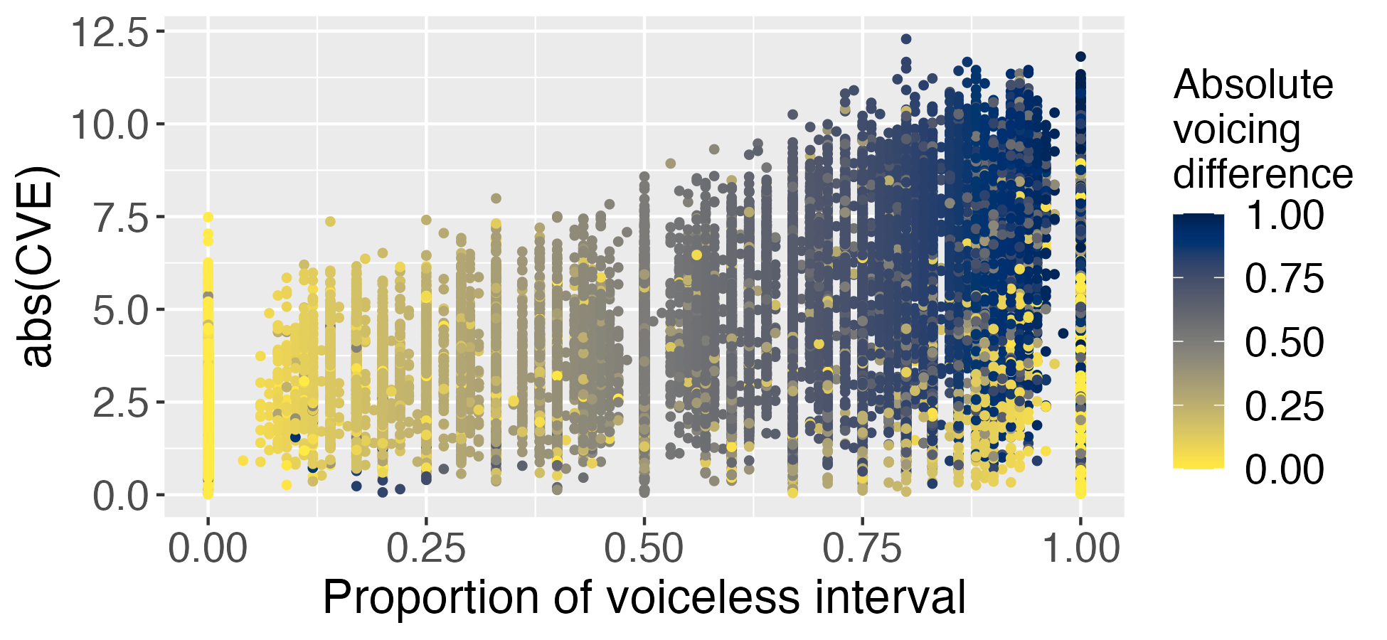

Slide 50
Lenis obstruent & MinEffort (Vowel height)
Kim et al (2016): subset of the same dataset that I’m looking at
Deletion: /a/_/a/ is the deleting context (MinEffort prediction borne out?)
However, they also found:
Left vowel context: /a/, /i/ > other vowels 🤨
Right vowel context: /a/, /i/, /i/, /ɔ/ > other vowels 🤨
They did not control for other known factors for the lenition of lenis obstruents (e.g., speech rate)

Slide 51
Lenis obstruent & LowInfo (frequency/predictability)
Choi et al (2006) : production experiment
No lexical token frequency effect for lenis word-medial voicing
But only checked for bilabial
The “frequent” words they looked at were not very frequent (there were much more frequent words for other places of articulation, e.g., velar) 🧐

Slide 52
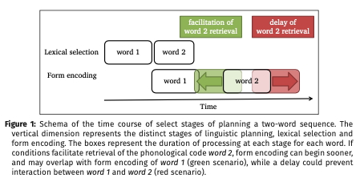
Production planning hypothesis?
The model of production in the Production Planning Hypothesis is designed to model categorical processes. (categorical, in the sense that the rule has either applied or not)
Figure 1 from Kilbourn-Ceron, Clayards and Wagner (2020) Laboratory Phonology

Slide 53
Production planning hypothesis?
If the conditioning environment from the following word becomes “available” in the form encoding of word 1, then the segment at the end of word 1 can be flapped
Figure 1 from Kilbourn-Ceron, Clayards and Wagner (2020) Laboratory Phonology

Slide 54
Production planning hypothesis?
Maybe to model a gradient process like the lenis obstruent lenition we looked at, we might want to assume that the amount of the form encoding of the second word overlapping with that of the first word is somehow reflected as the degree of lenition?
Figure 1 from Kilbourn-Ceron, Clayards and Wagner (2020) Laboratory Phonology

